Slide 1
Buddhism in cambodia
Ven. Kimpicheth Chhon
Khemara Student Association, MCU

Slide 2
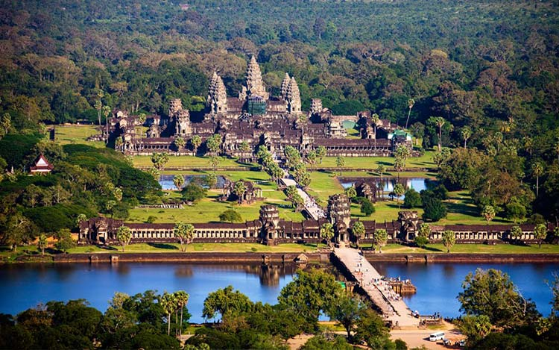
Cambodia is called the kingdom of wonder
Because the Great Angkor Wat and more than three thousands of ancient monuments in the country

Slide 3
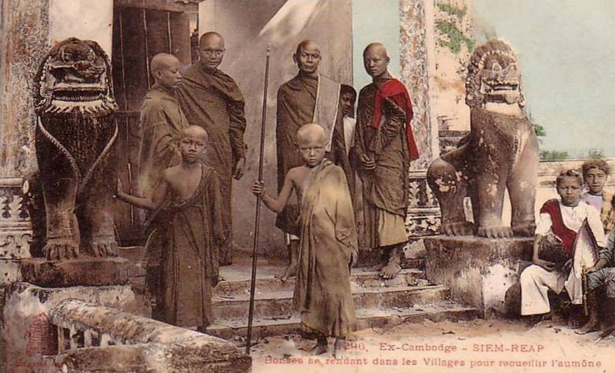
7 Wonders of Buddhism in cambodia you should know!

Slide 4
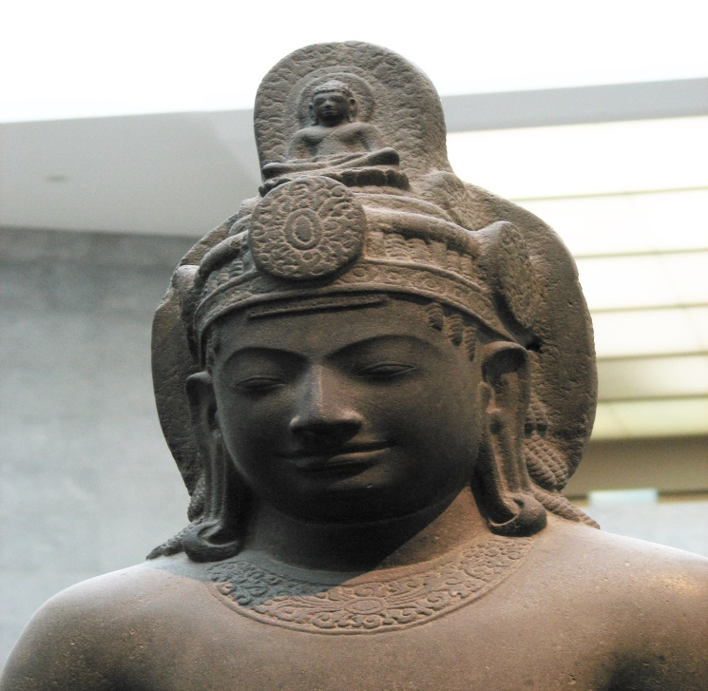
Cambodia used to be the Mahayana Buddhist country
1
Why there is no single Mahayana monk and people don’t even know that their ancestors were practicing Mahayana Buddhism?
Cambodian statue of Avalokiteśvara Bodhisattva.
Sandstone, 7th century CE.

Slide 5
Hinduism, Buddhism, and Muslim are always in Cambodia and now including Christianity
2
But there is no religious conflict in the history…why?

Slide 6
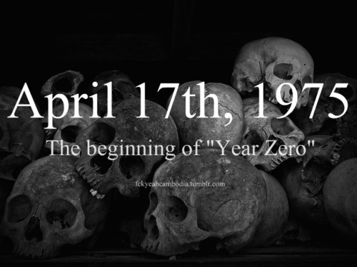
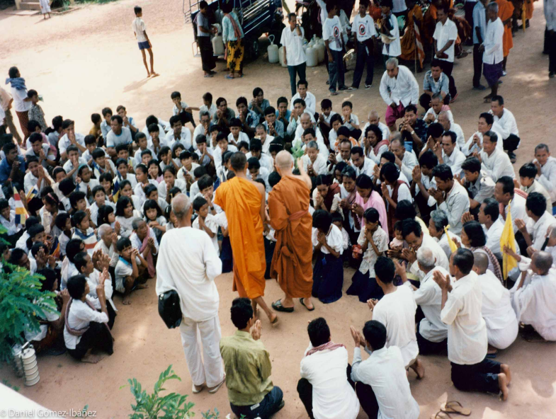
Buddhism had completely destroyed from the country several times
3
But how can Buddhism always return to be the main religion of Cambodia?

Slide 7
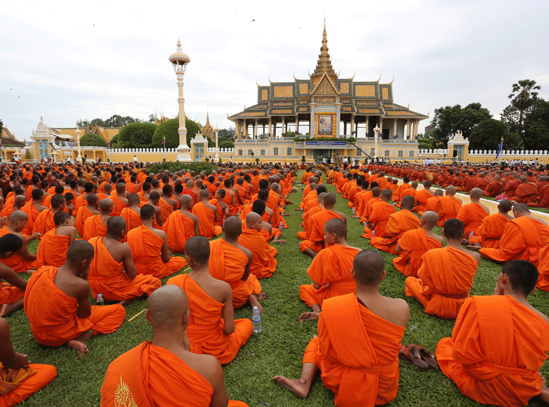
the world Most youngest population & The world youngest Sangha leaders
4

Slide 8
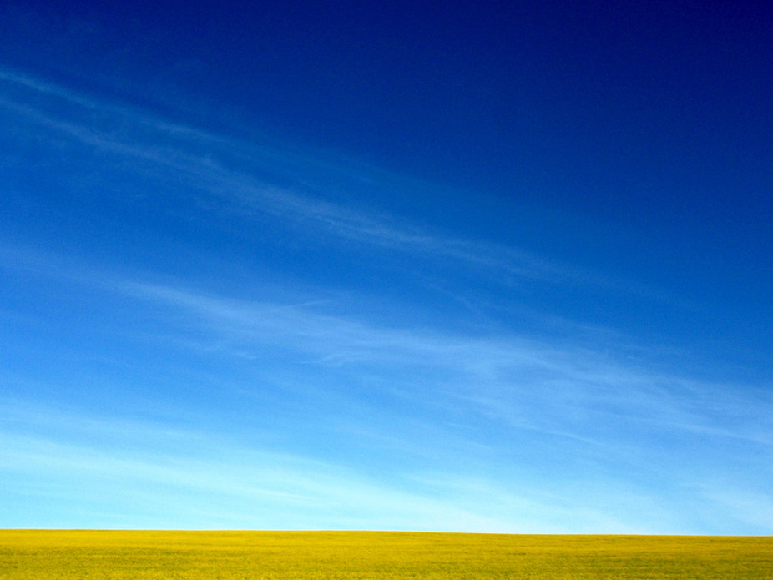
CamBodian Buddhism is like The sky after the big storm
5
People of new generation learn Buddhism through questions not beliefs
“Liberal” and “Conservative”

Slide 9
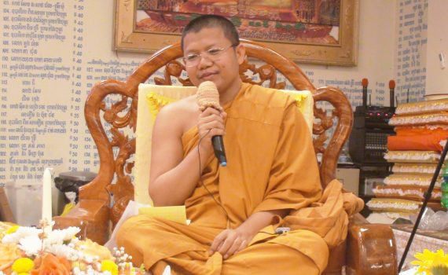
Buddhist masters
6
Who are they? I know you are thinking about the MONKS!
BUT…Teaching Buddhism is liberal in Cambodia
Ven. San Sochea, Monk Master
Buth Savong, Lay Master

Slide 10
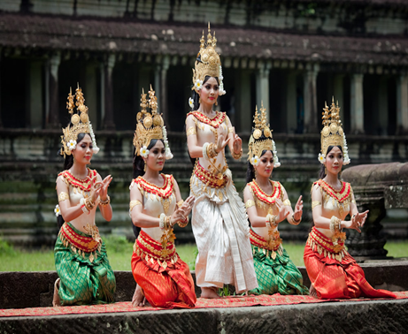
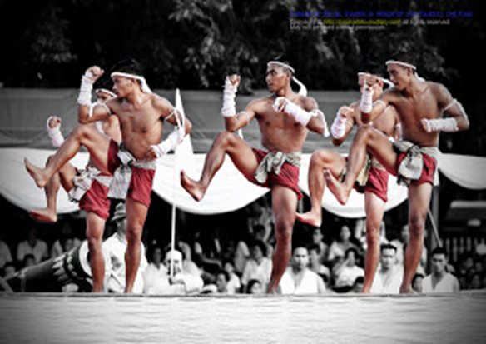
Culture, art and belief
7
Where is BLACK MAGIC
?

Slide 11
Thank you!

