Slide 1
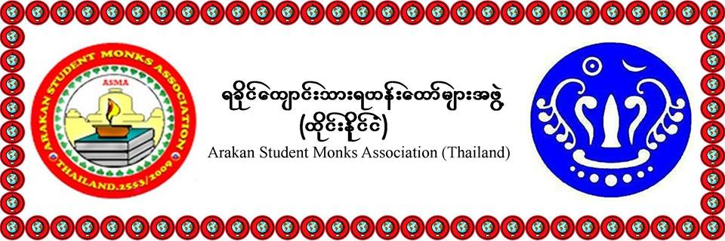
MCU, THAILAND

Slide 2
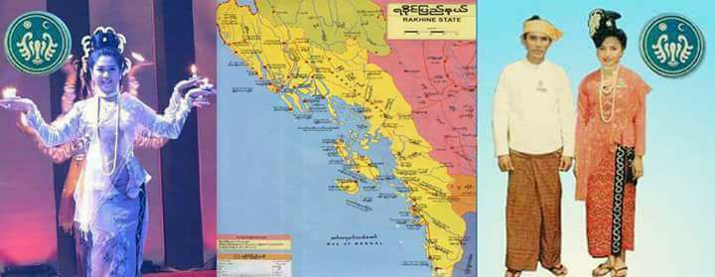
HISTORY OF ARAKAN
Area 36,778.0 km²
Population 3,188,807

Slide 3
BUDDHISM IN ARAKAN

Slide 4
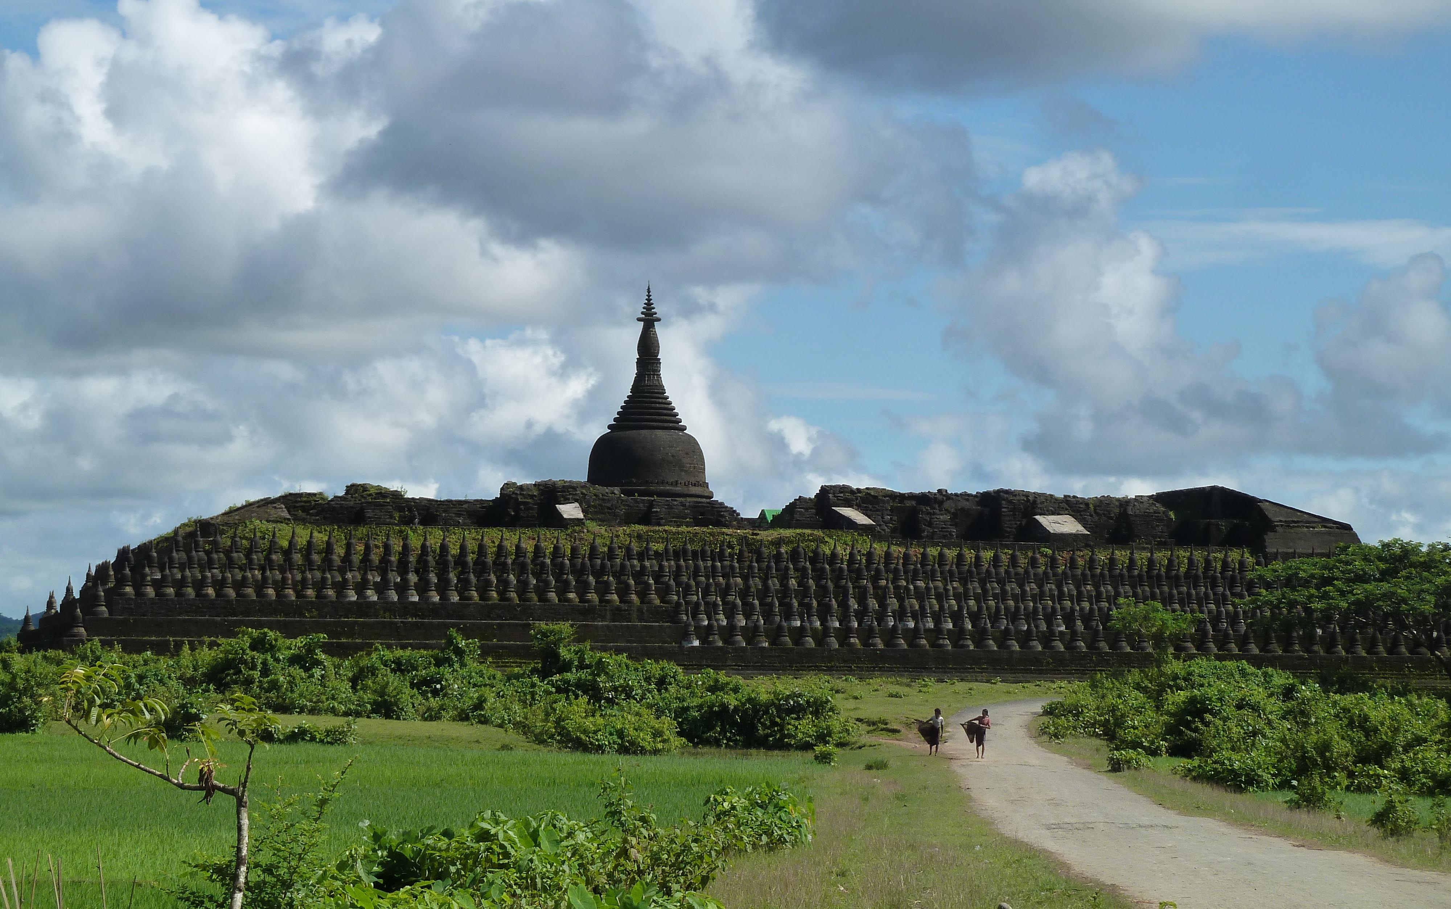
90000 Pagoda( ကိုးေသာင္း ဘုရား)
KING- MIN THIKKHA
YEAR= 1553
LENTH=250 ANVIL/ 230
HIGH= 30 ANVIL

Slide 5
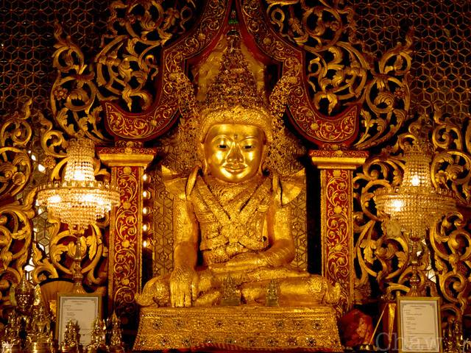
Mahamyatmuni image
KING…
SANDATHURIYA
AD= 146
BC= 483

Slide 6
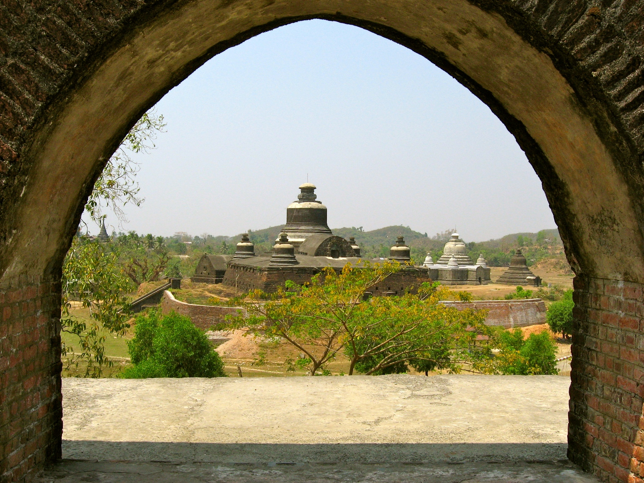
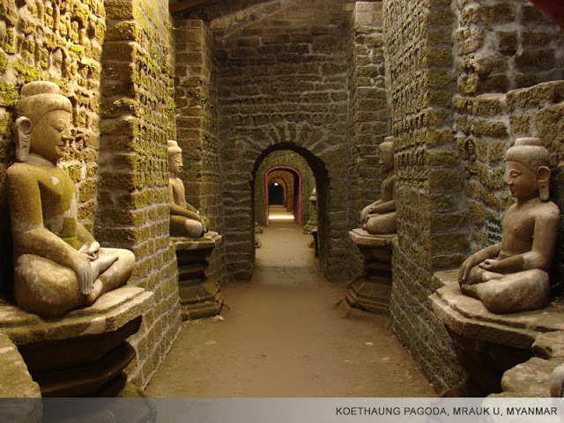
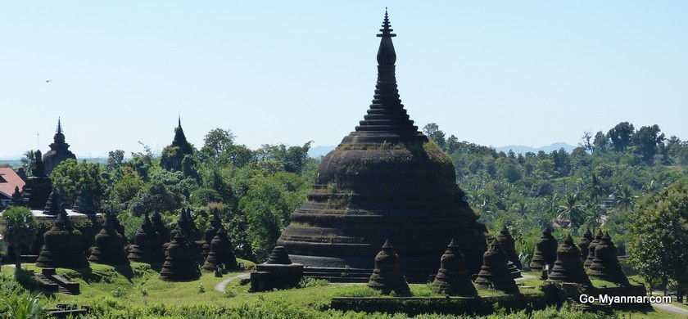
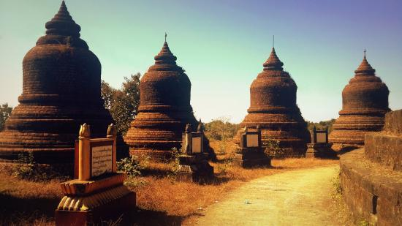

Slide 7
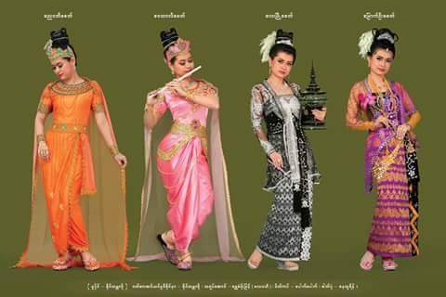
Culture of Arakan

Slide 8
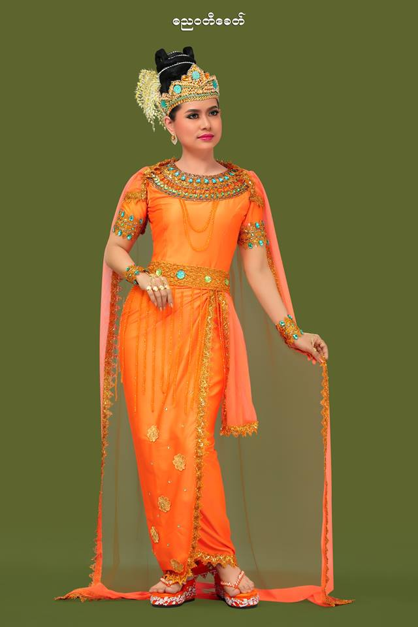
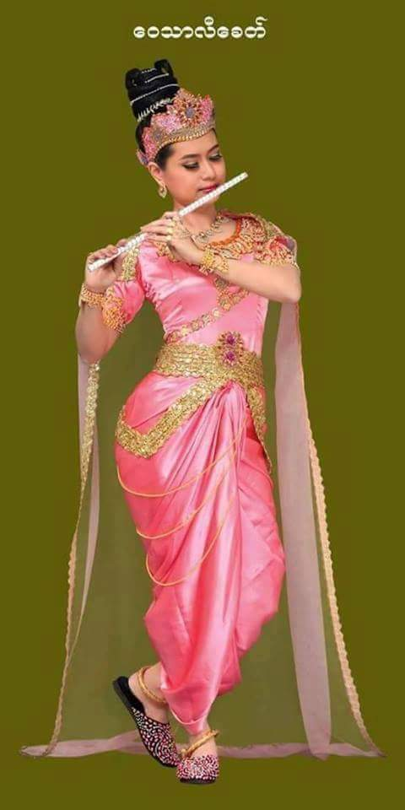
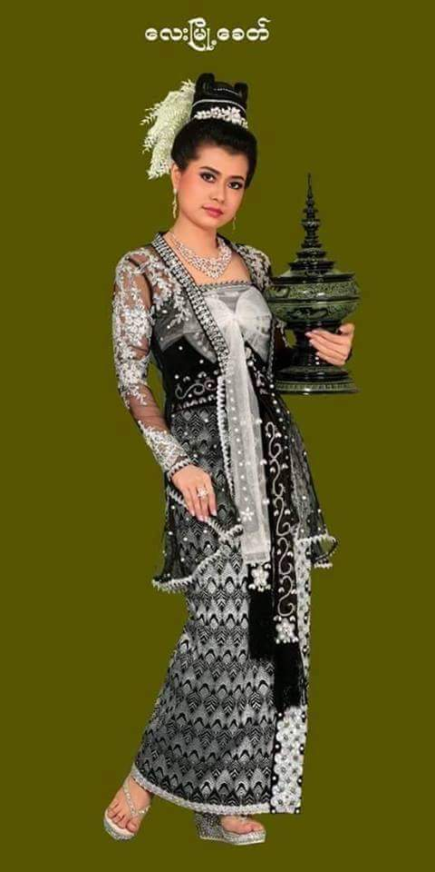
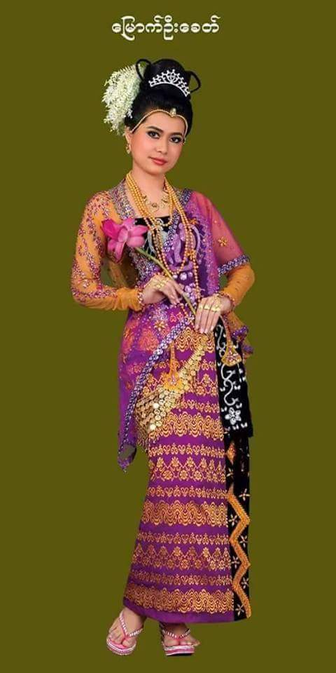
BC
3325 AD
326
AD
327 AD
818
AD
818
AD
1430
AD
1430
AD
1784

Slide 9
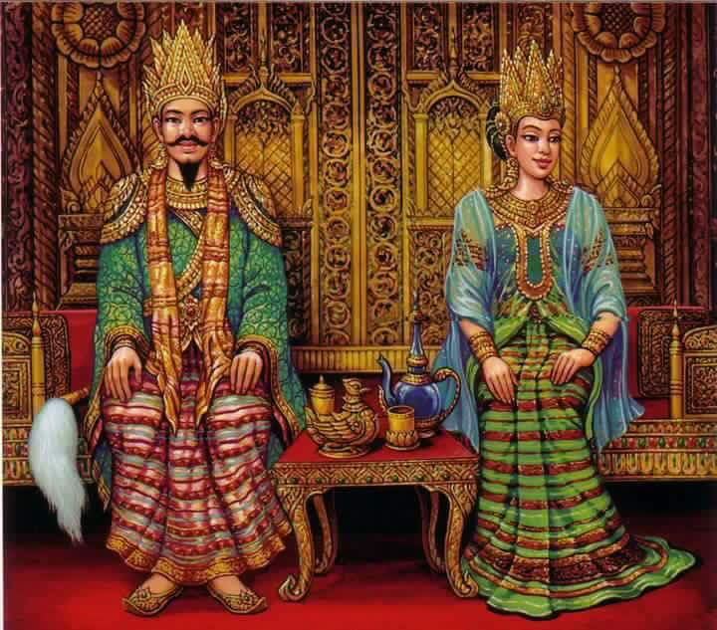
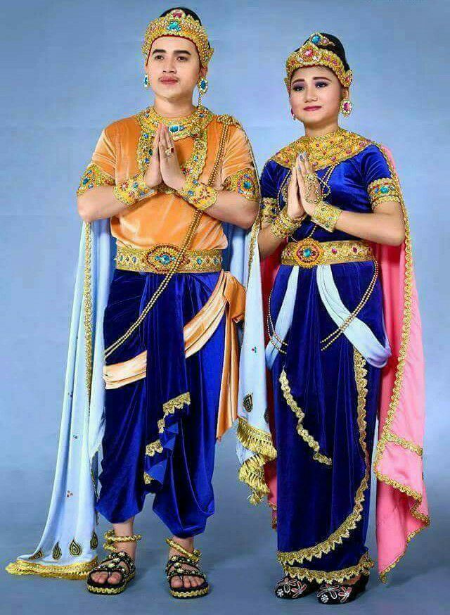
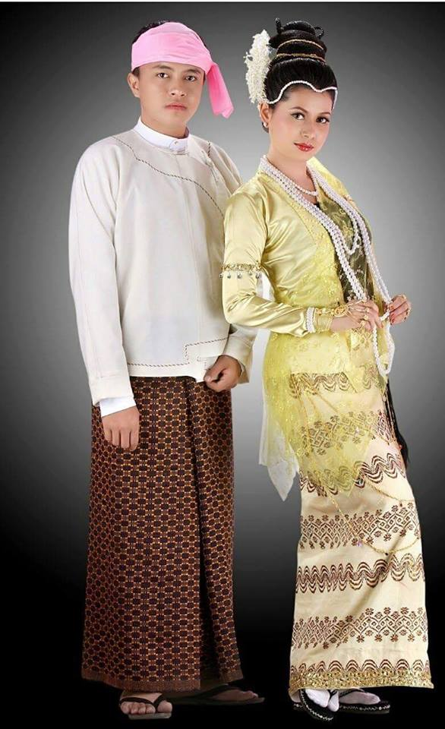

Slide 10
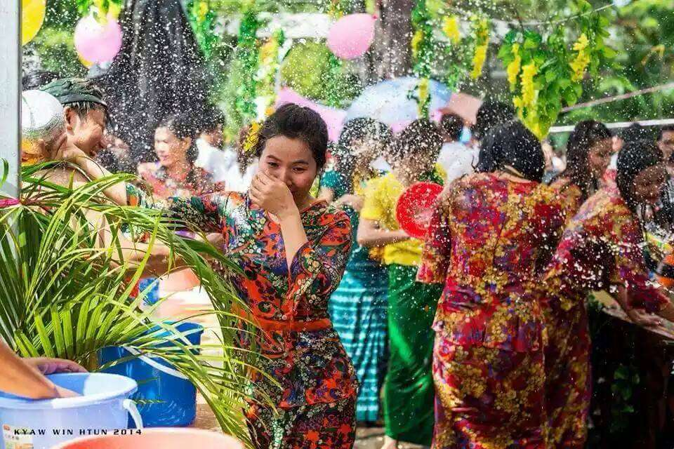
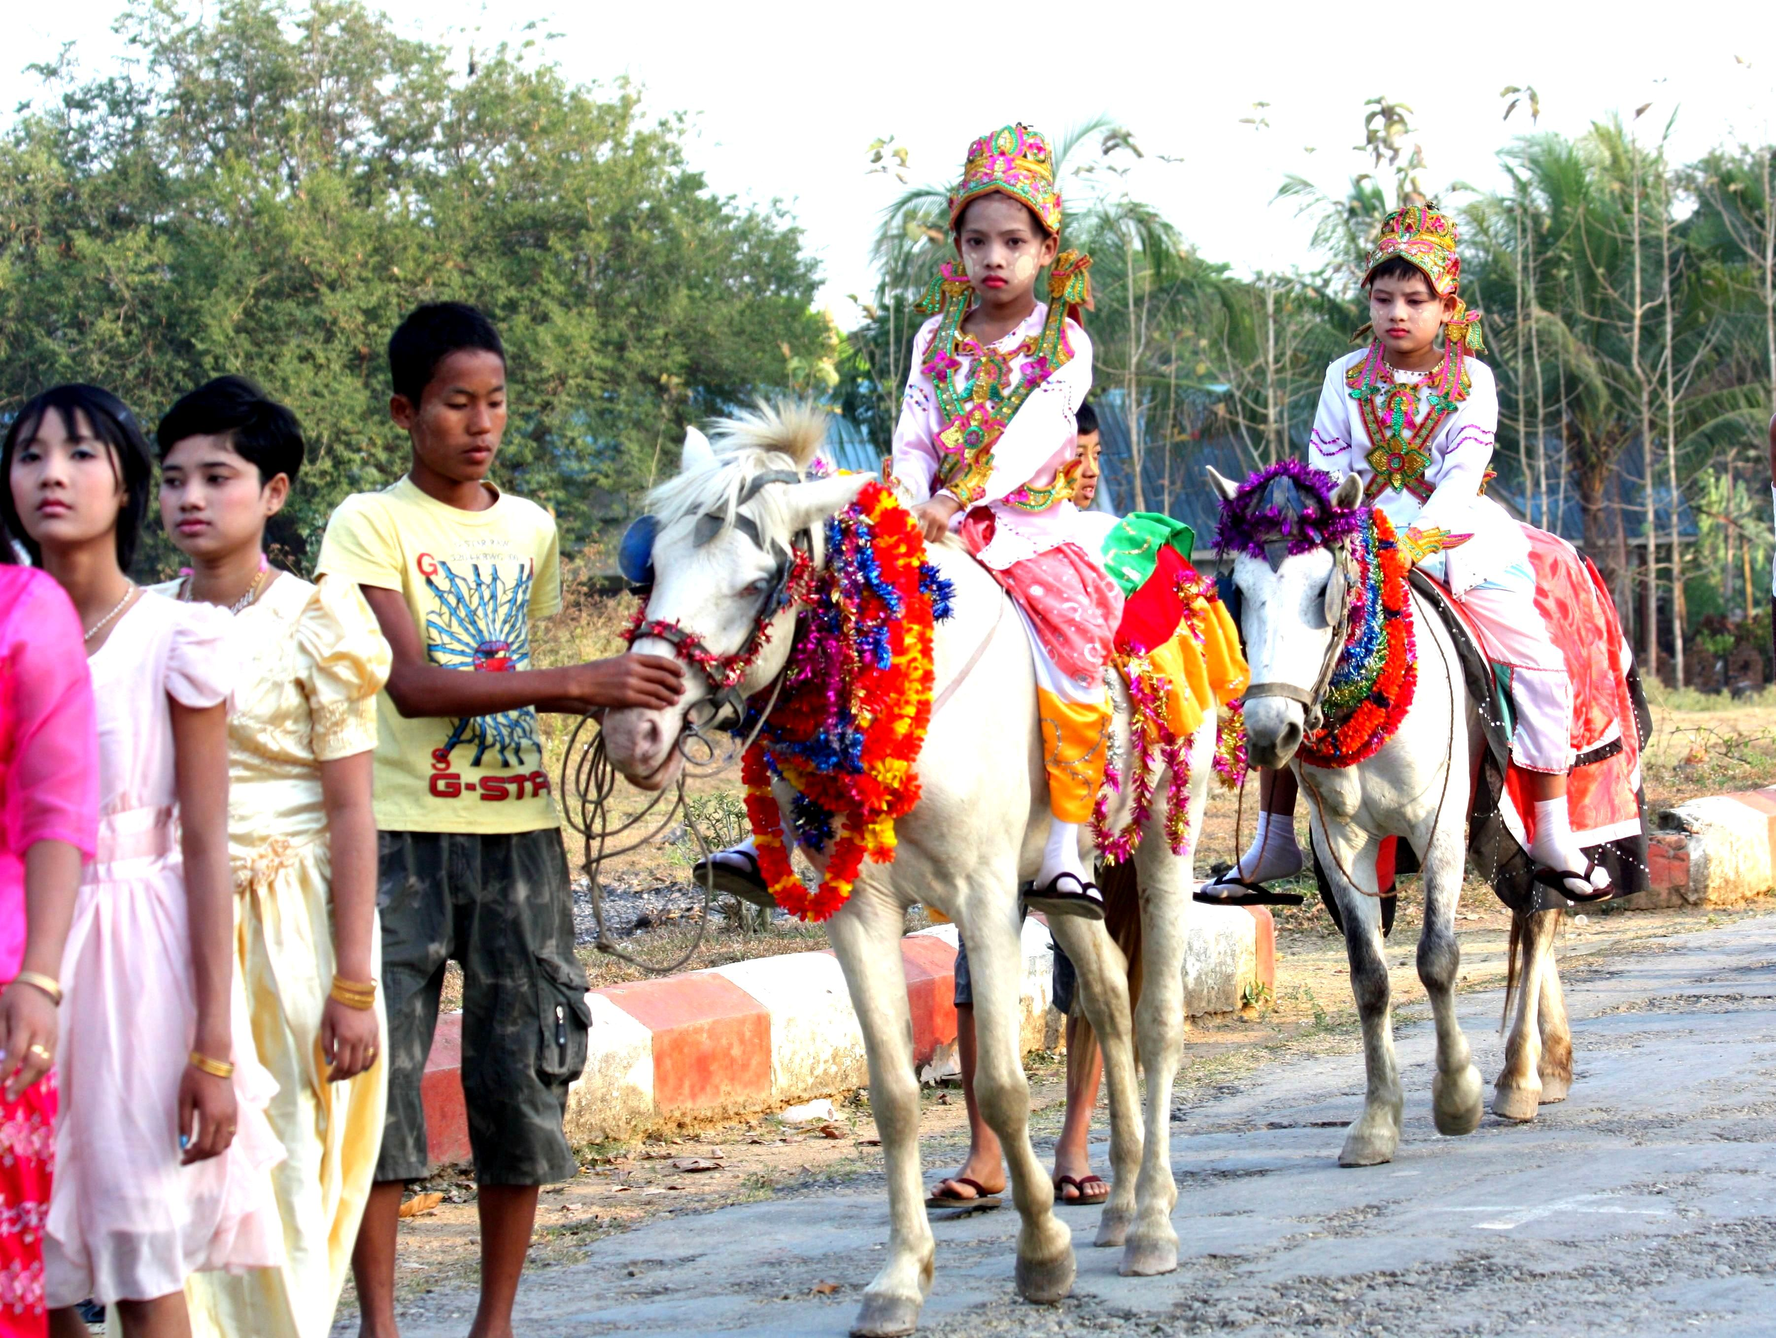
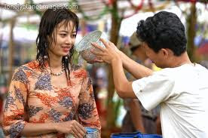
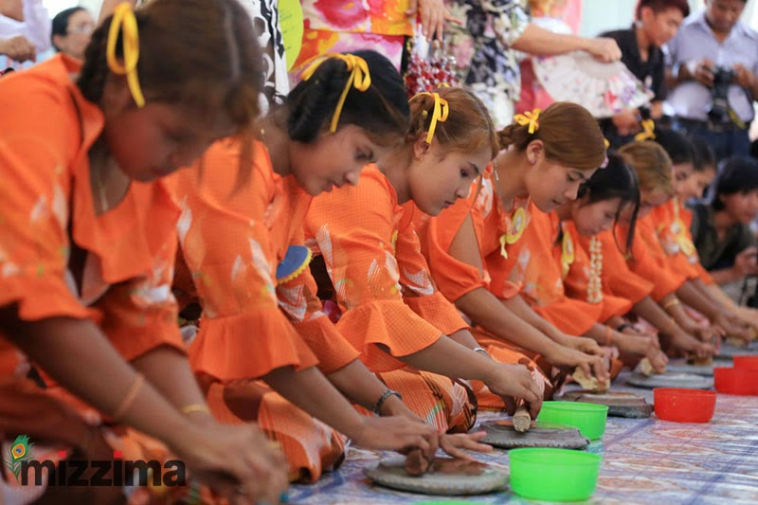

Slide 11
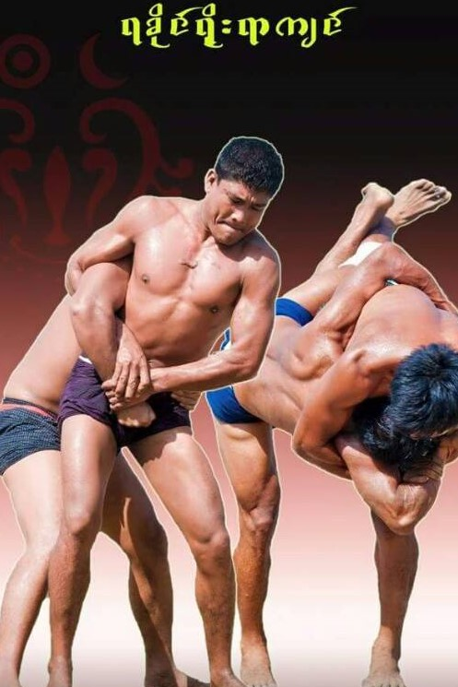
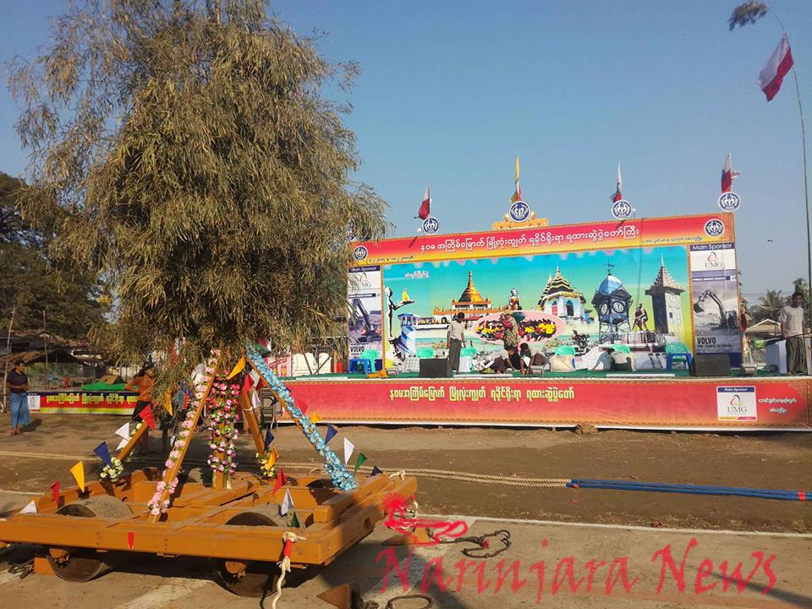
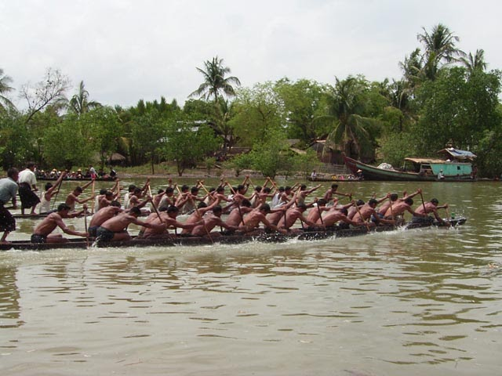
TRADITIONAL
ရထားဆဲြပဲြ
က်င္ပြဲ
ျပိဳင္ေလာင္းျပိဳင္ပြဲ

Slide 12
THE LORD OF BUDDHA&THE KING OFARAKAN
THE KING OF SANDATHURIYA( 55)
BC 5 WAS INVITED TO THE LORD BUDDHA TO VISIT ARAKAN COUNRYT.

Slide 13
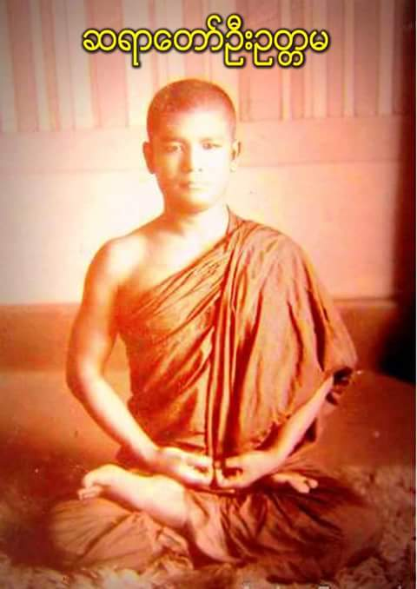
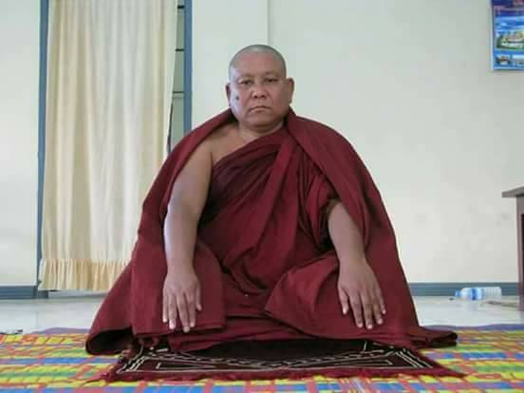
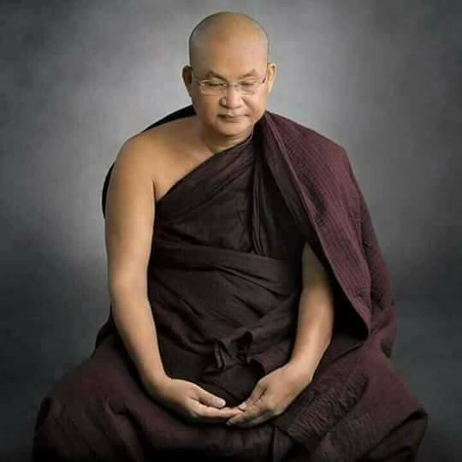
THE MOST VENERABLE MONK IN ARAKAN
VEN OUTTAMA

Slide 14
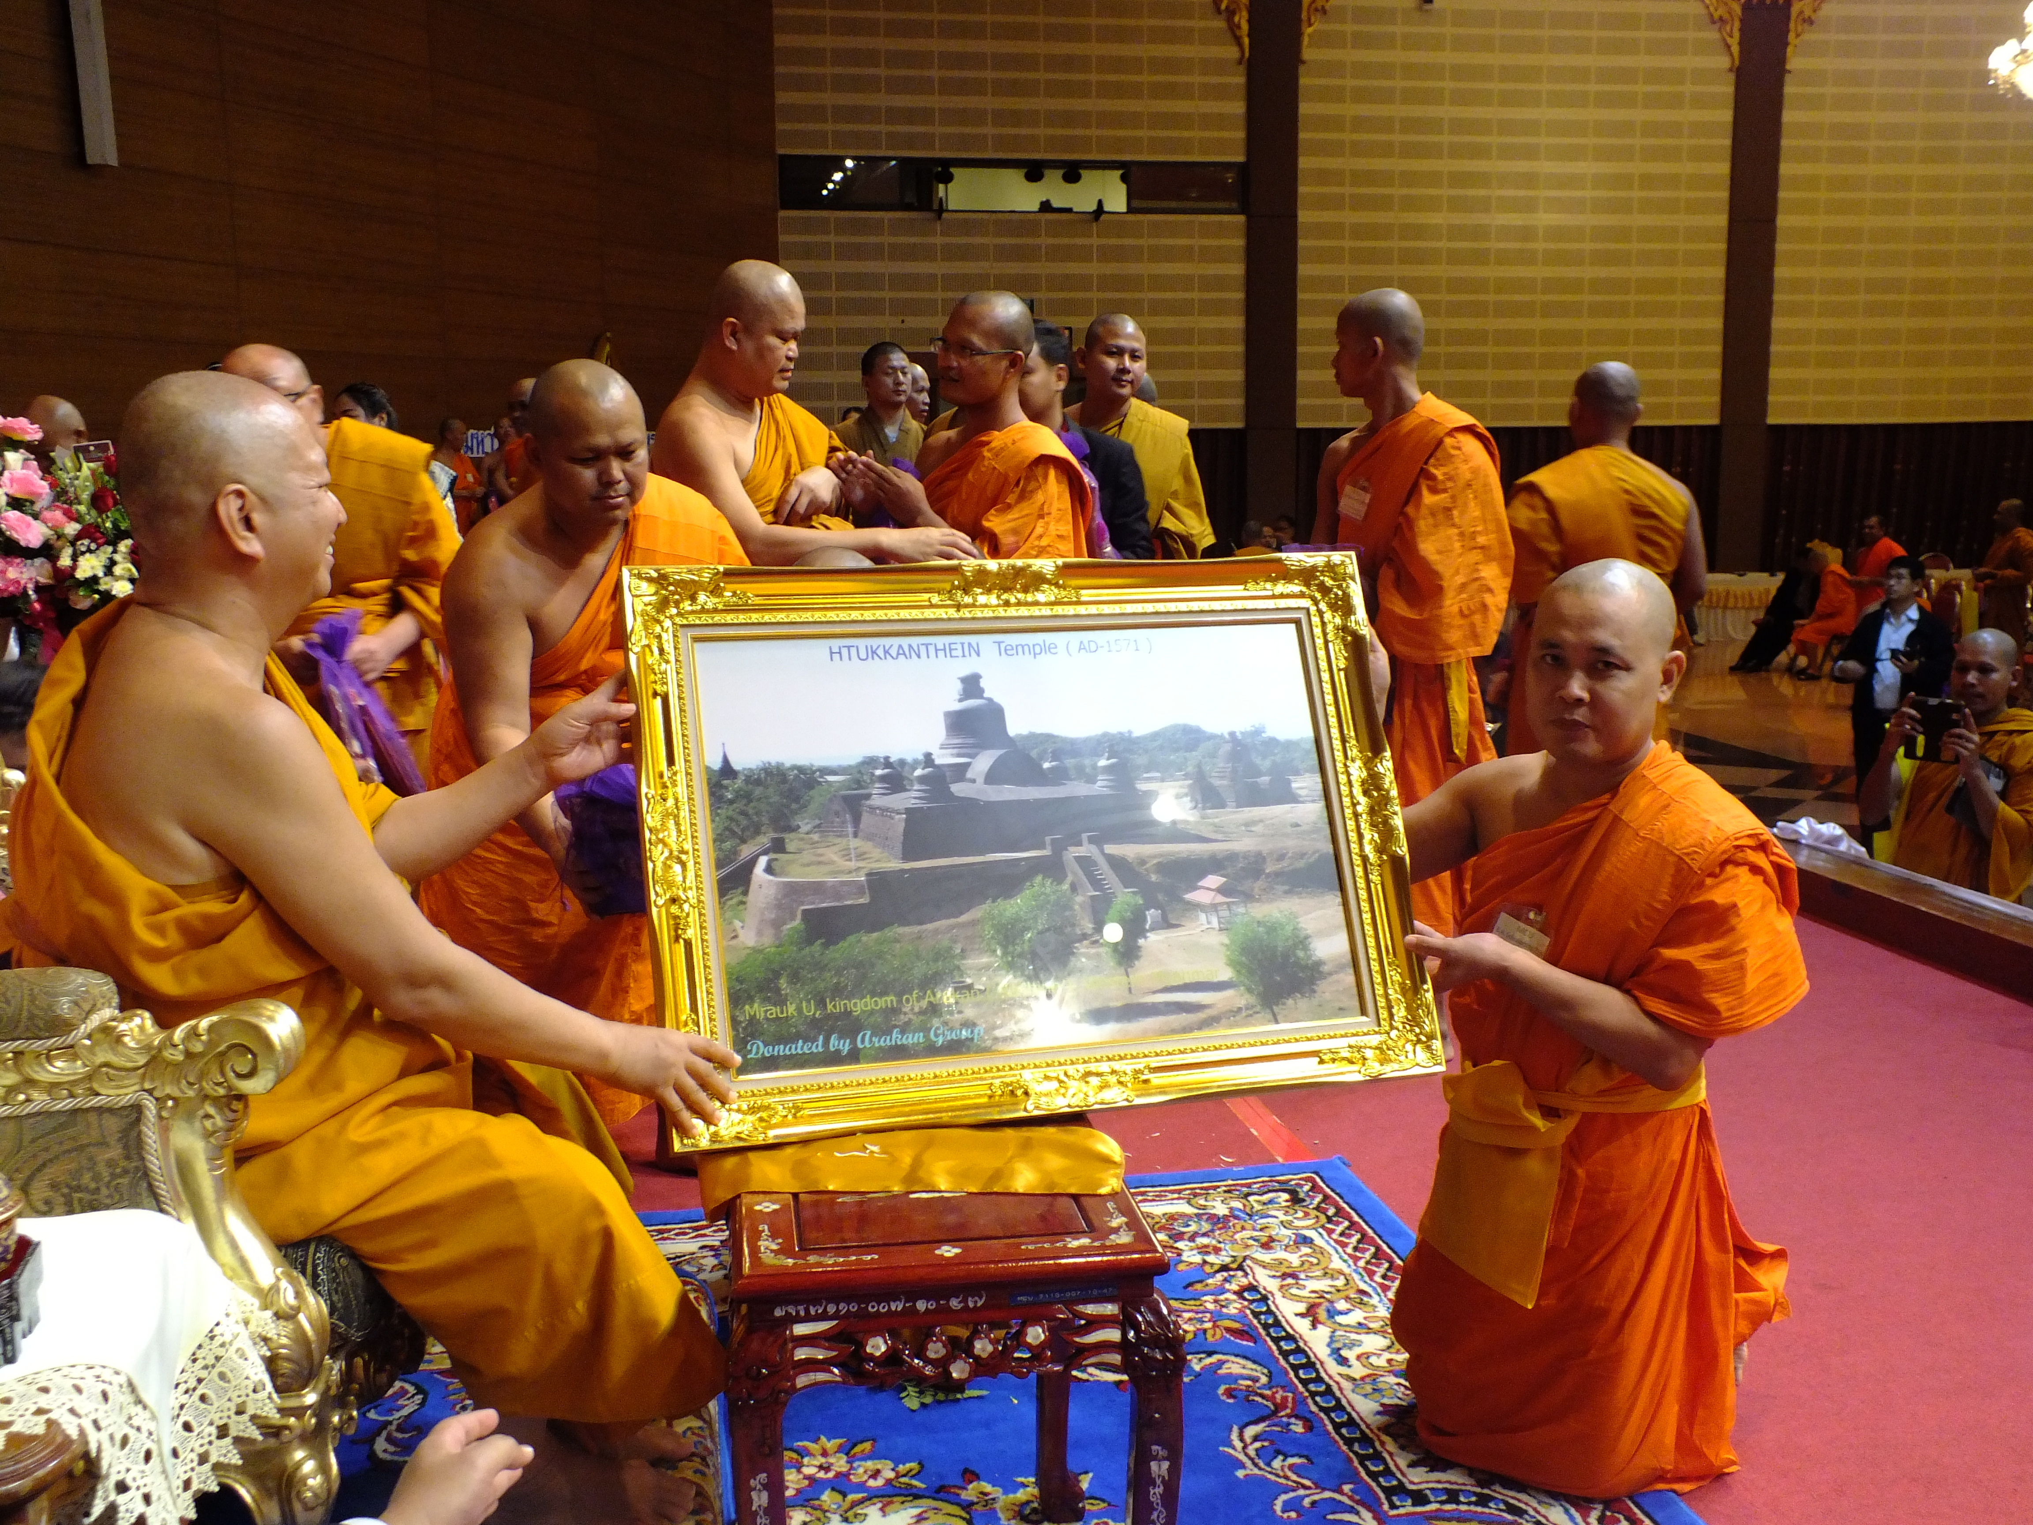
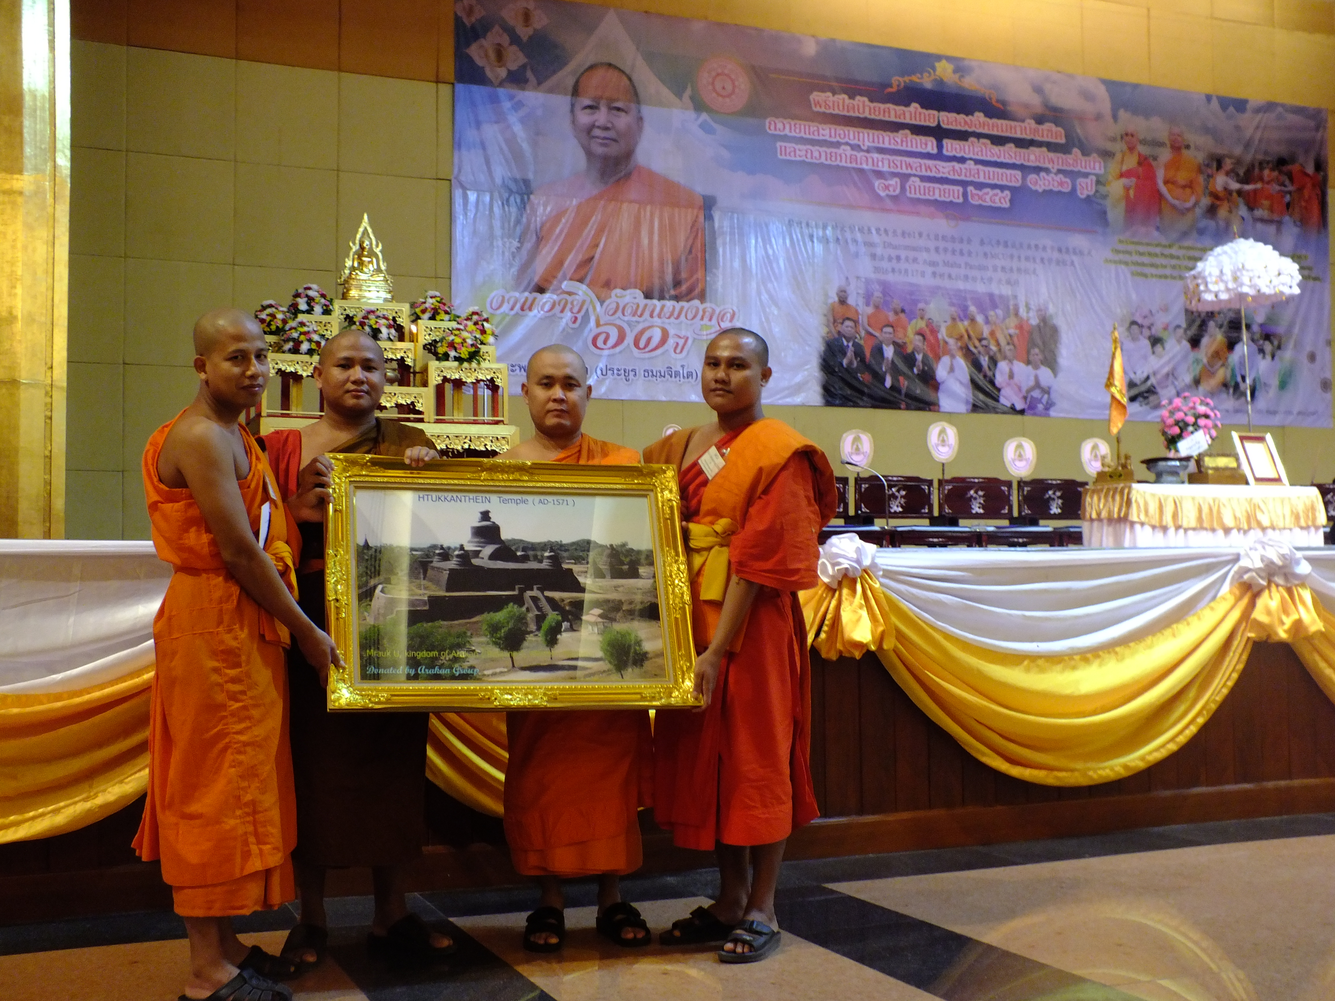
ARAKAN STUDENT CULB ACTIVITIES

Slide 15
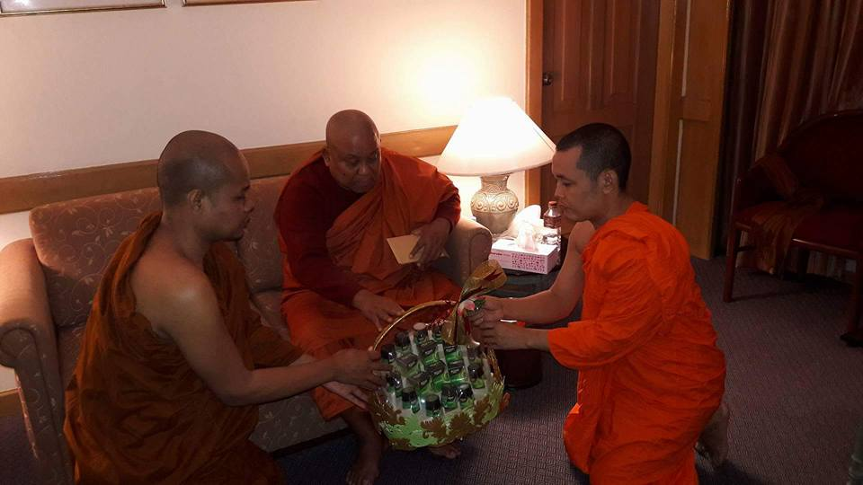
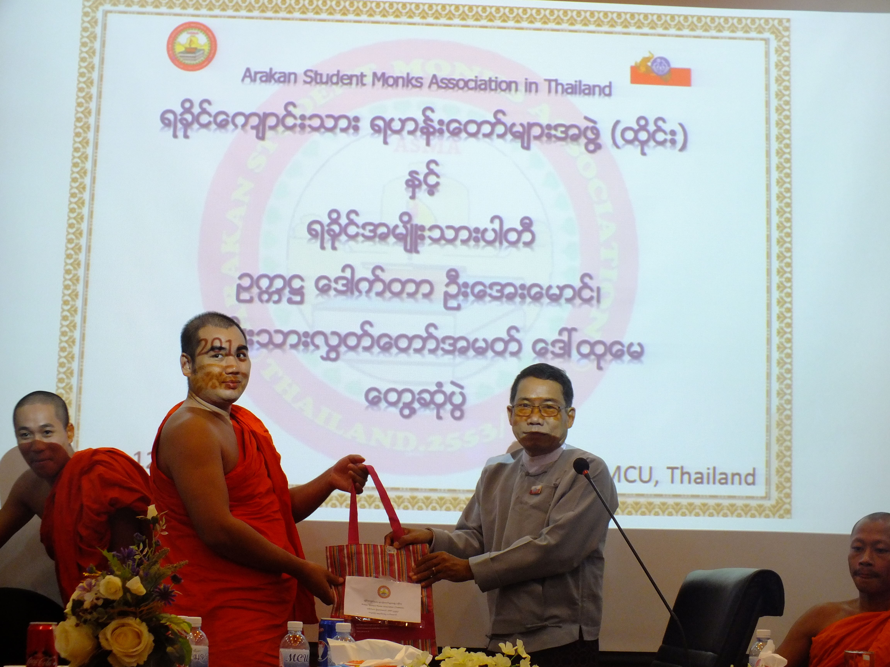
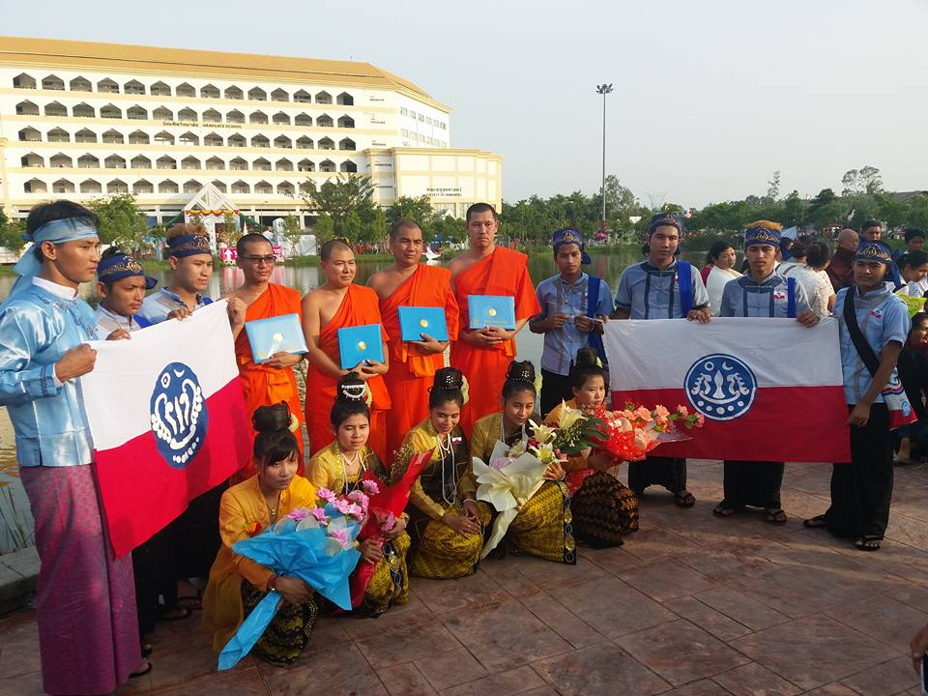
RELATIONSHIP ACTIVITIES

Slide 16
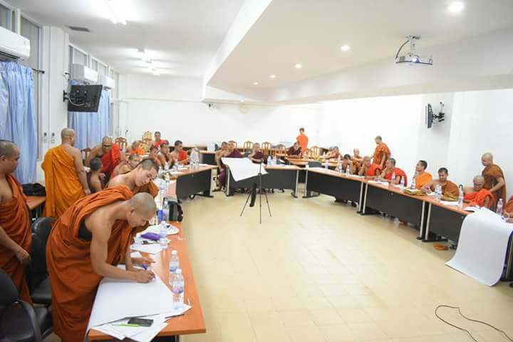
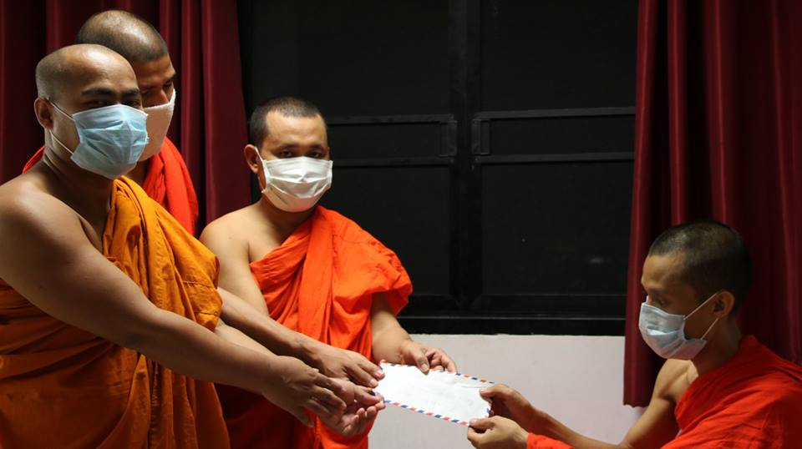
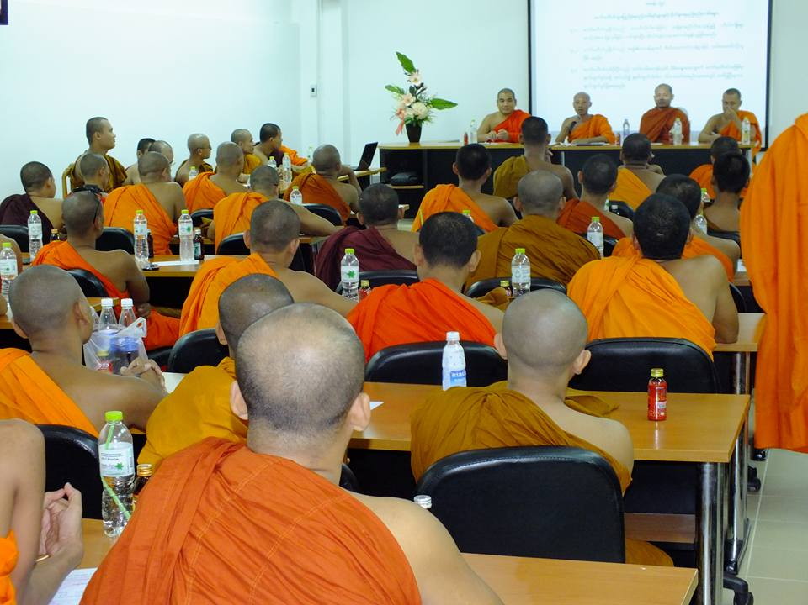
EDUCATION & HEALTHY ACTIVITIES

Slide 17
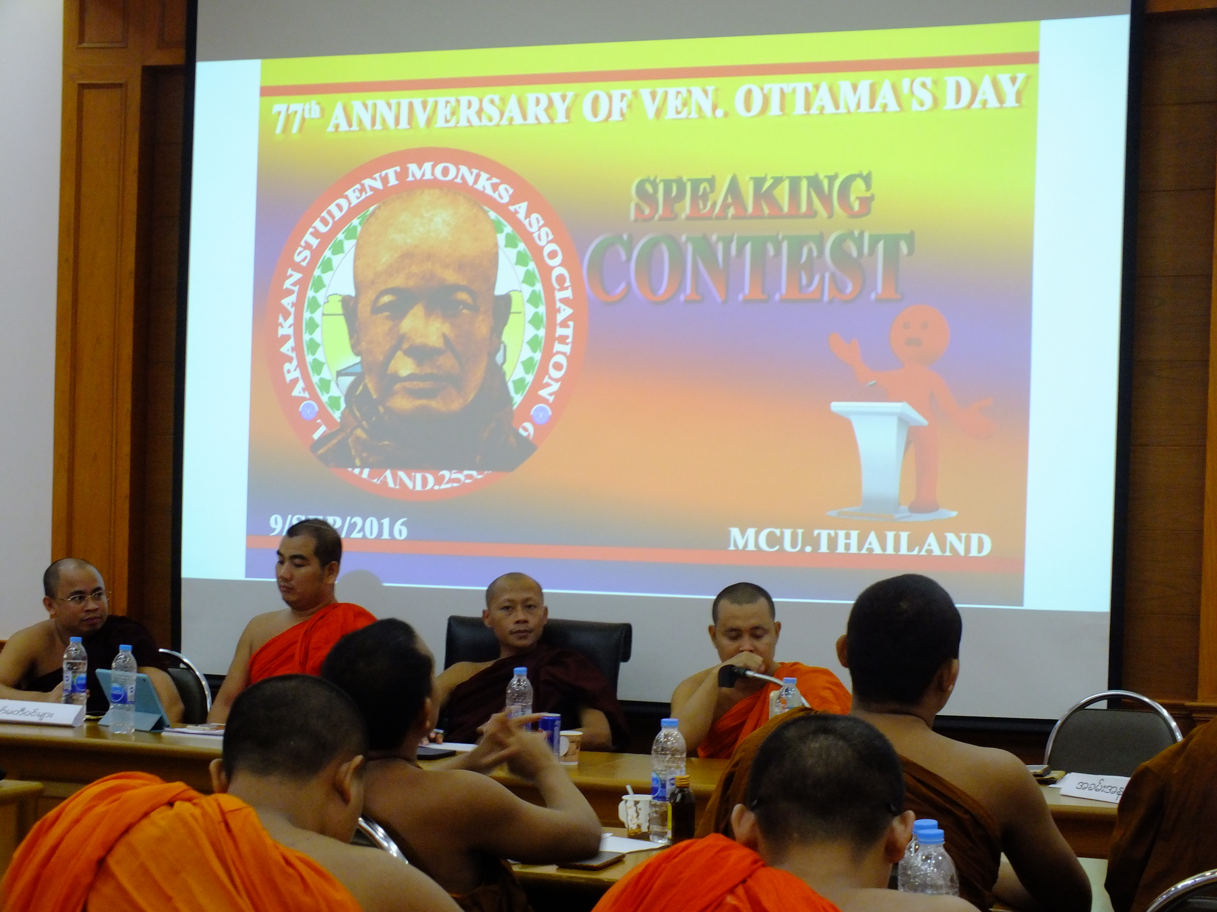
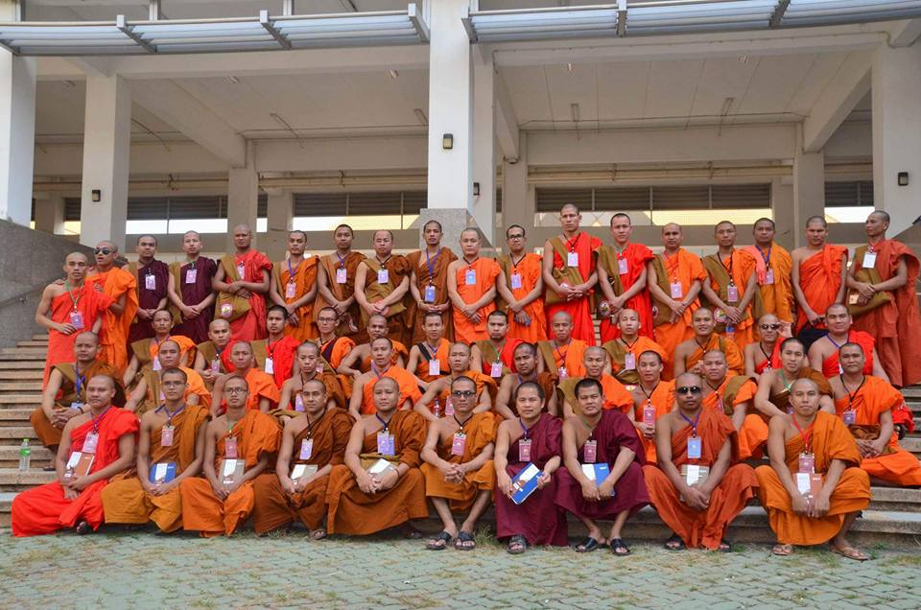
EVERY YEAR ACTIVITIES OF ARAKAN CLUB

Slide 18
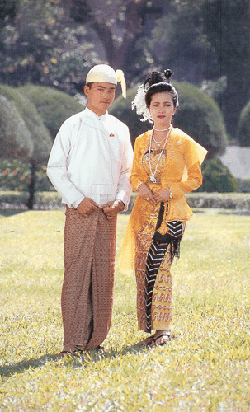
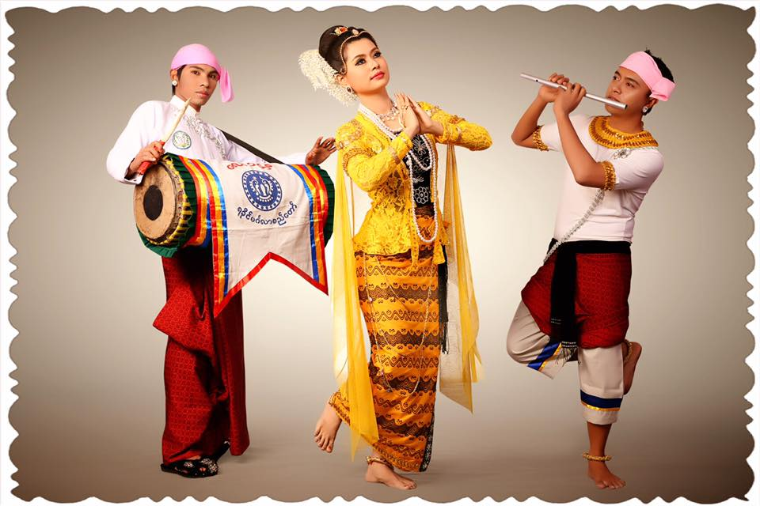
THANK YOU
HAVE A NICE DAY

